Slide 1
Presentation On Cause Of Death
Presented By:
Dipesh Limaje

Slide 2
Problem Statement
To apply analytical skills and to give findings and conclusions in detail about data analysis.
2) Causes of Death is an official determination of conditions resulting in a human’s death that resulted in or contributed to death, and the circumstances of the accident or Disease.

Slide 3
EDA Steps
1) Check data shape(Num. of Rows, Num. of Columns)
(6120,34)
So there are 6120 Rows and 34 Columns.
2) Check each data type of columns and missing Values
So from data.info, we get all the information related to data types, and after observing all data types they are all ok.
And after observing all values from columns there are no missing values.
3) Change the data types
After all observations, the data looks good we don't need to change any of the data types.

Slide 4
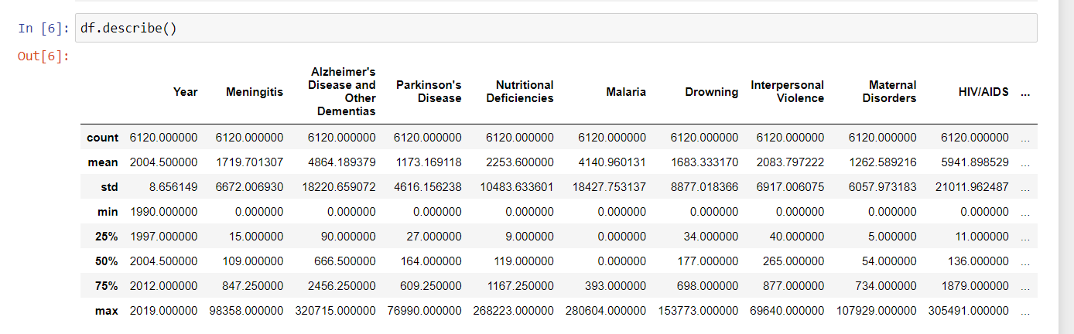
4) Summary Statistics
From this, we can see the data distribution that you have for each and determine whether there are outliers or not.
5) Check Duplicate values
Here we don't have any specific unique ID so here we can't remove the duplicate, and if try to remove it the data will become useless.

Slide 5
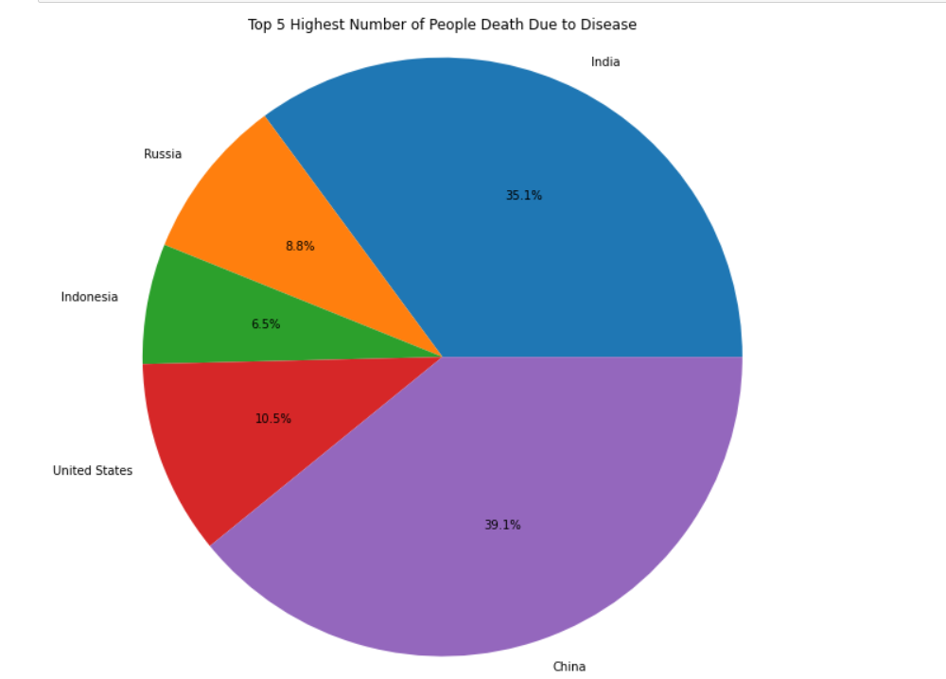
6) See the data distribution and data anomaly
The above pie chart shows the Top 5 Countries in which the Total Number of death is the highest among all countries.
1] China 39.1%
2] India 35.1%
3] United States 10.5%
4] Russia 8.8%
5] Indonesia 6.5%
Now we select these top 5 countries for further analysis
now we are going to analyze top 10 reasons why people die so much in the top 5 country

Slide 6
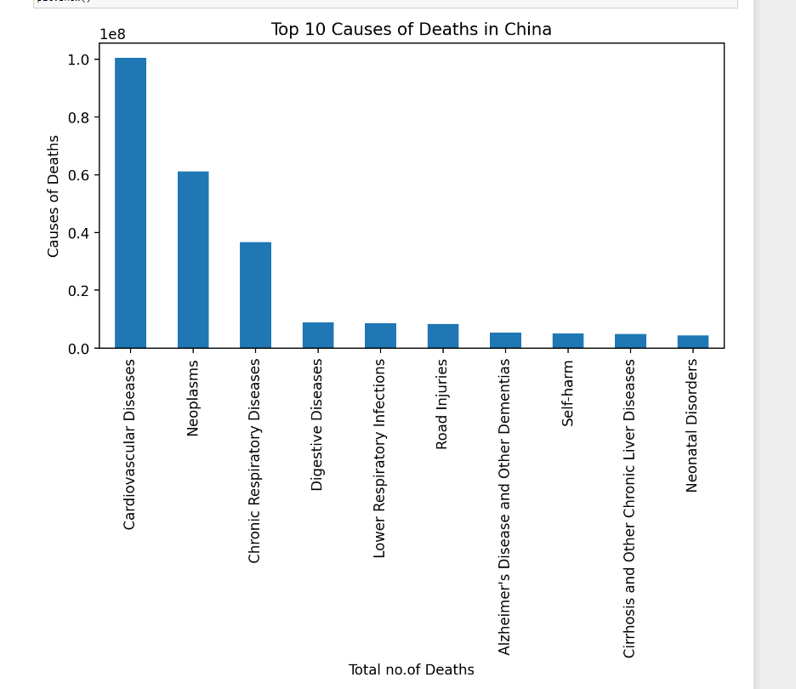
Top 10 cause of death in China
The above bar chart shows the top 10 diseases why people death is more in China, first and the main reason is due to Cardiovascular Disease followed by Neoplasms and Chronic Respiratory Disease.

Slide 7
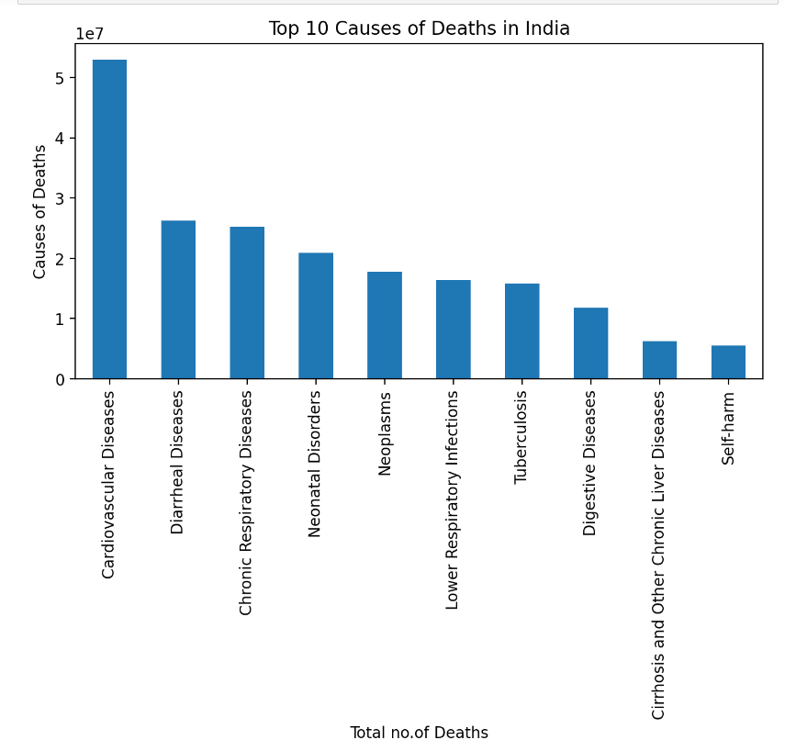
Top 10 causes of death in India
The above bar chart shows the top 10 diseases why people death is more in India, first and the main reason is due to Cardiovascular Disease followed by Diarrheal Disease, Chronic Respiratory Disease, and Neonatal Disorders.

Slide 8
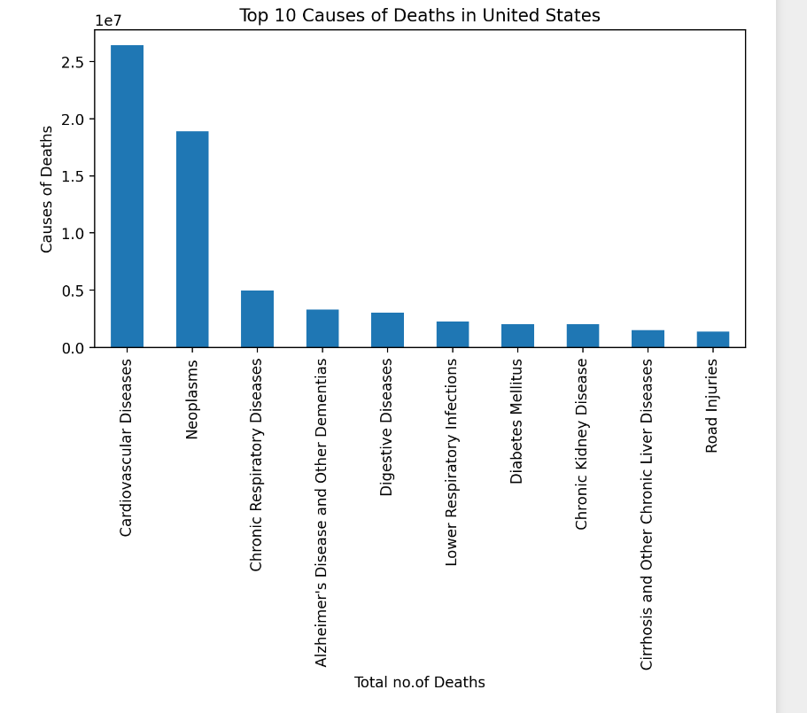
Top 10 cause of death in United States
The above bar chart shows the top 10 diseases why people death is more in the United States, first and the main reason is due to Cardiovascular Disease followed by Neoplasms.

Slide 9
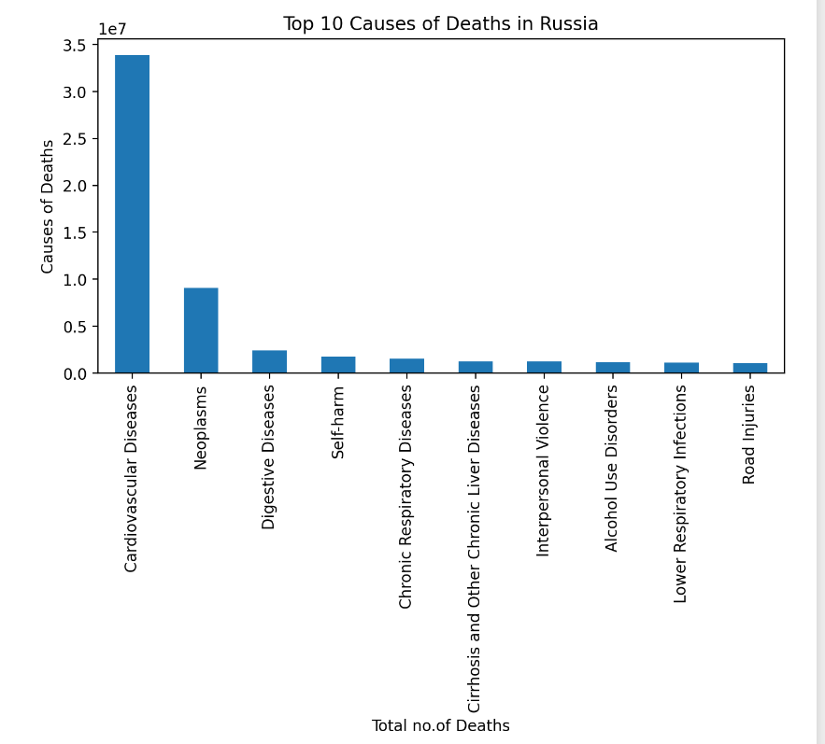
Top 10 cause of death in Russia
The above bar chart shows the top 10 diseases why people death is more in Russia, first and the main reason is Cardiovascular Disease followed by Neoplasms.

Slide 10
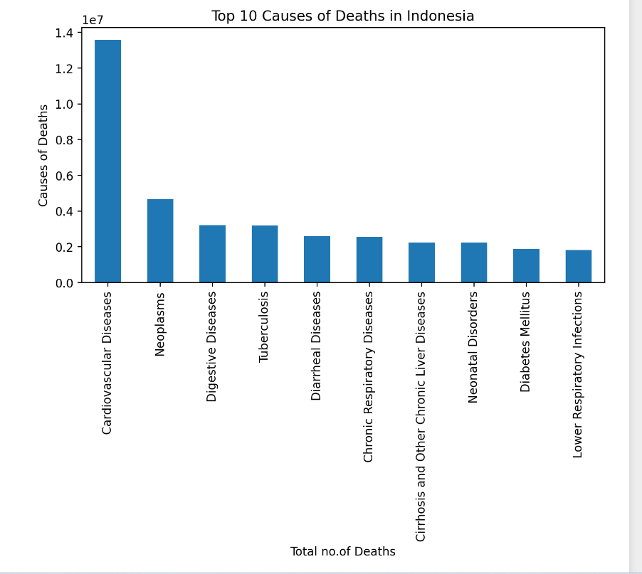
Top 10 cause of death in Indonesia
The above bar chart shows the top 10 diseases why people death is more in Indonesia, first and the main reason is due to Cardiovascular Disease followed by Neoplasms and Digestive Diseases.

Slide 11
Now Comparing All Disease With these top 5 countries to observe which Country is most affected by which Disease.

Slide 12
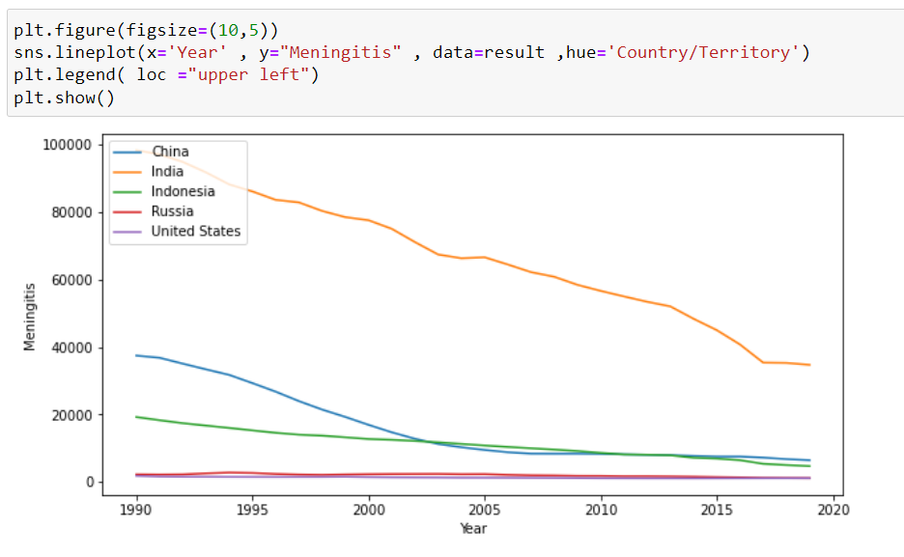
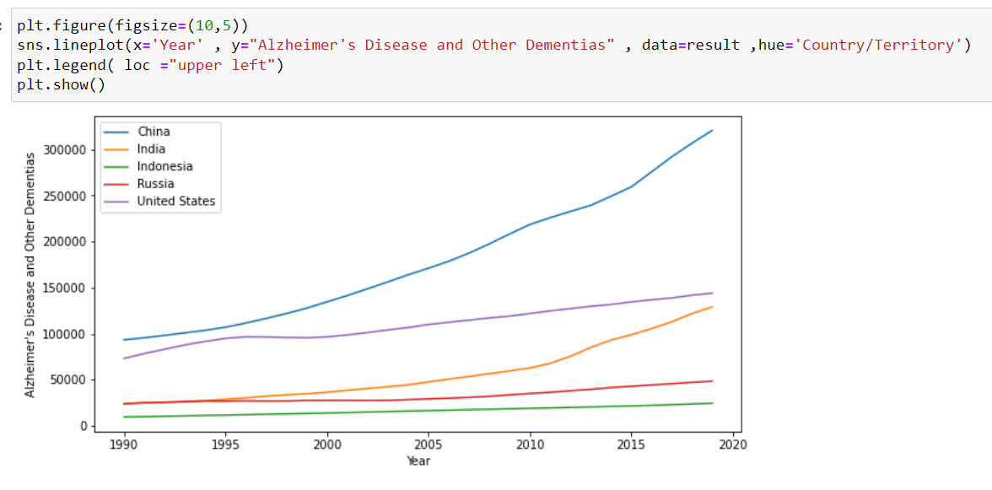
Meningitis VS Country
From the above Line graph, we observe people dying due to Meningitis was high in India in starting 1990 and now in 2019 it gradually decreases, the same condition in Indonesia and china but we also observe very few people die due to Meningitis in Russia and the United states. and we also observe except for India in 2019 the death ratio of people is more than in the rest of the 4 countries.
Alzheimer’s Disease and other Dementias VS Country
From the above Line graph, we observe people dying due to Alzheimer's Disease and Other Dementias were low in starting year (1990) but it is gradually increasing as time passes, From the above graph we also observe china is more affected as compared to the other 4 countries.

Slide 13
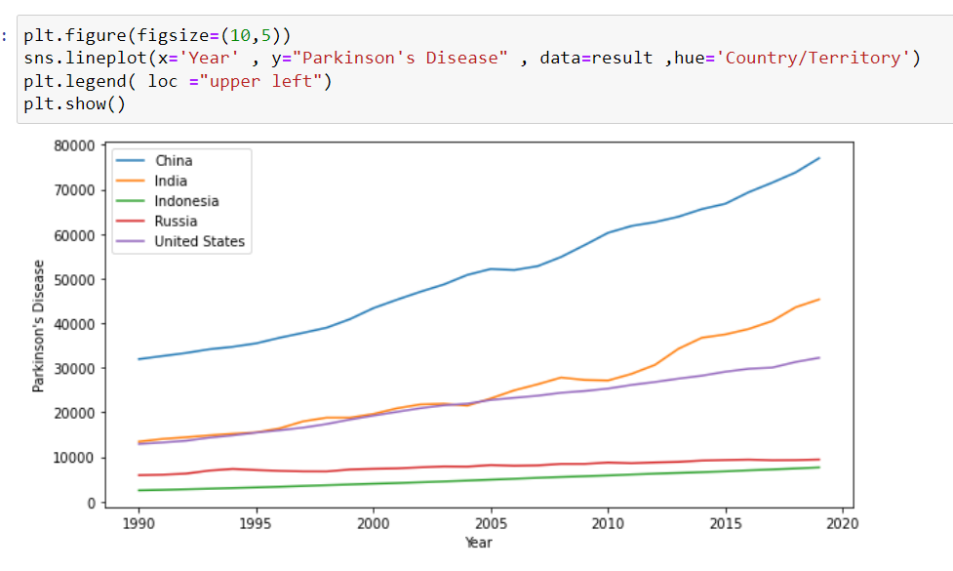
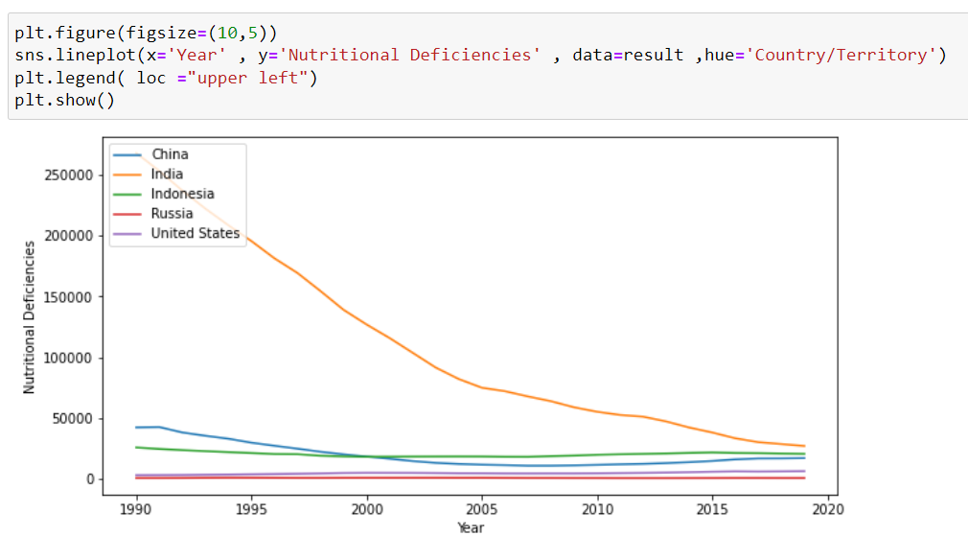
Parkinson's Disease VS Country
From the above Line graph, we observe people dying due to Parkinson's Disease were low in starting year (1990) but it is gradually increasing as time passes, From the above graph we also observe china is more affected as compared to the other 4 countries.
Nutritional Deficiencies VS Country
From the above Line graph, we observe people dying due to Nutritional Deficiencies was very high in India but we observe there is a sudden decrease from the year 2004 and now people dying due to Nutritional Deficiencies in 2019 are almost equal to all other 4 countries which are less than 50000 people.

Slide 14
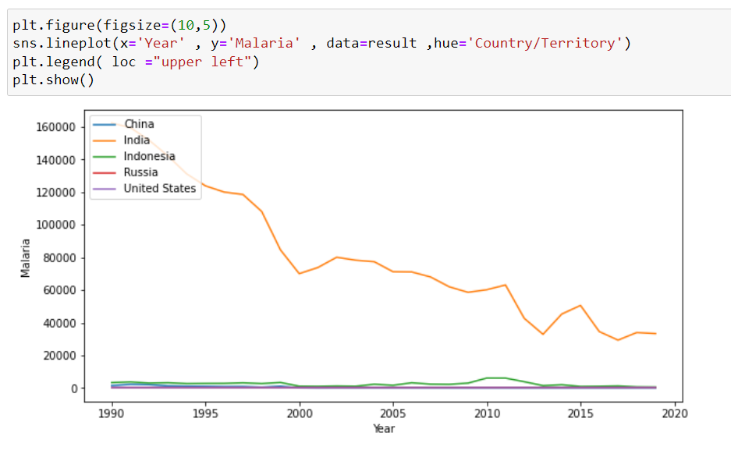
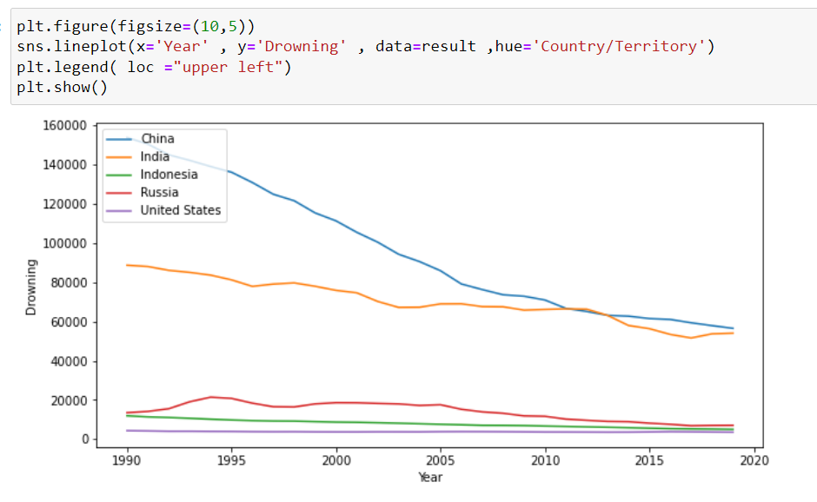
Malaria VS Country
From the above Line graph, we observe people dying due to Malaria is very high in India there is a gradually decrease from the year 1990 to 2019 but people dying due to Malaria is high as compared to the remaining 4 countries in the year 2019, but we also observe country affected by Malaria is only India.
Drowning VS Country
From the above Line graph, we observe people dying due to Drowning is very high in China and Followed by India but they gradually decrease as time passes but not enough in the remaining countries the number of people dying due to Drowning is less than 20000.

Slide 15
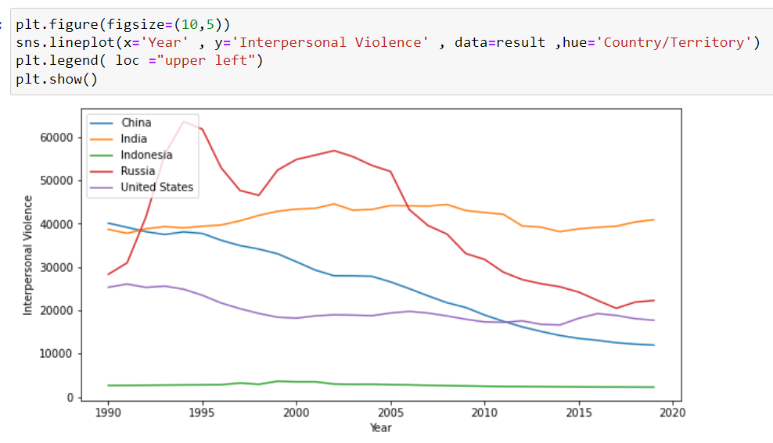
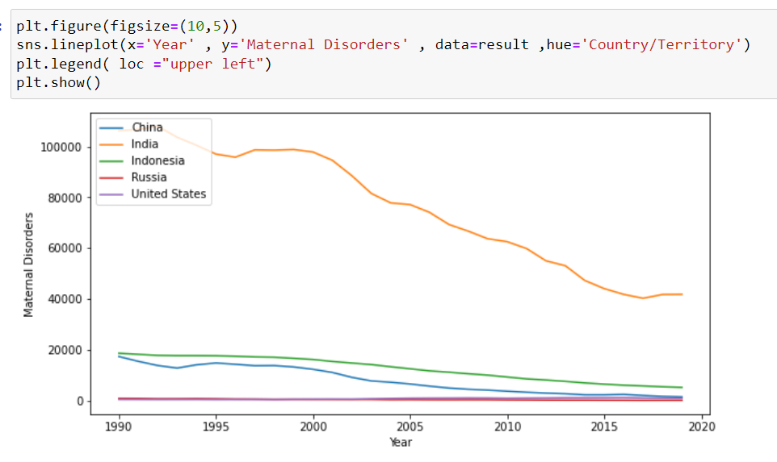
Interpersonal Violence VS Country
From the above Line graph, we observe people dying due to Interpersonal Violence is high in all Countries except Indonesia, as from the graph we observe the number of people who died due to Interpersonal Violence is Russia till 2005 and then it is gradually decreasing, but for India, it is constant at 40000 and for china and united states it is gradually decreasing from the year 1990 to the year 2019.
Maternal Disorders VS Country
From the above Line graph, we observe people dying due to Maternal Disorders are high in India and are gradually decreasing followed by Indonesia and China but as compared to other countries India's death is more in the year 2019.

Slide 16
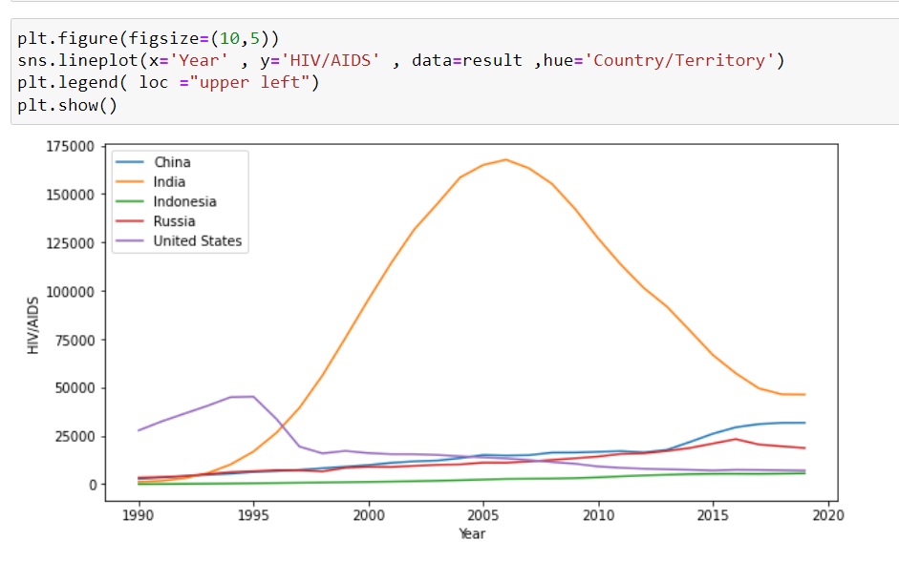
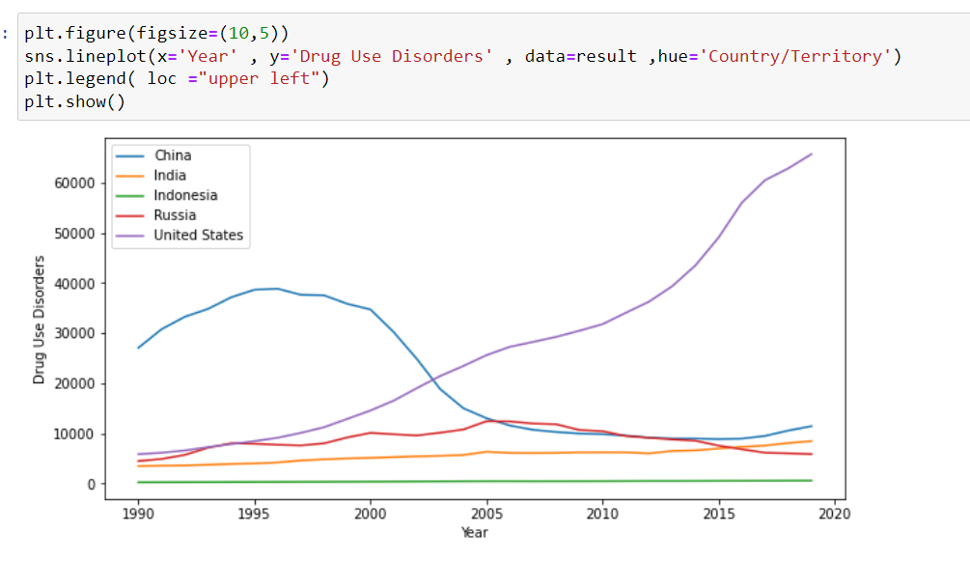
HIV/AIDS VS Country
From the above Line graph, we observe people dying due to HIV/AIDS are less starting the year 1990 except in the United States but after 1997 the people death is decreasing till 2019, India after 1992 the number of people die due to HIV/AIDS is sudden increase and continues till 2006 and after 2007 the people die due to HIV/AIDS id gradually decrease.
Drug Use Disorders VS Country
From the above Line graph, we observe people dying due to Drug Use Disorders was high in China but suddenly decrease after 2000 year but in the united states the death of people due to Drug Use Disorders is increasing since the year 1990 and sudden increase in the year 2005 and continues increasing at last and for other 3 countries it remains constant under 10000.

Slide 17
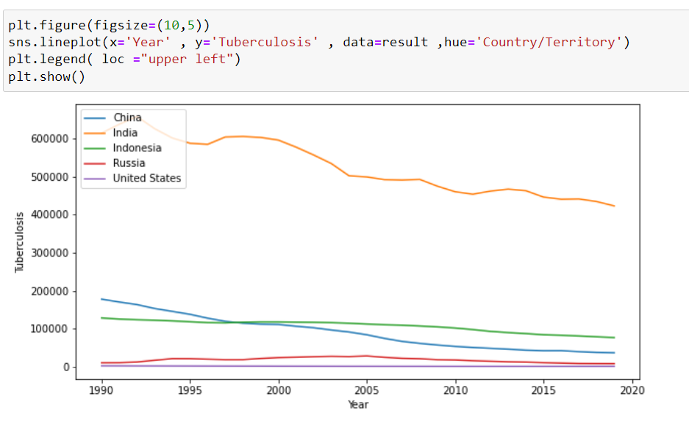
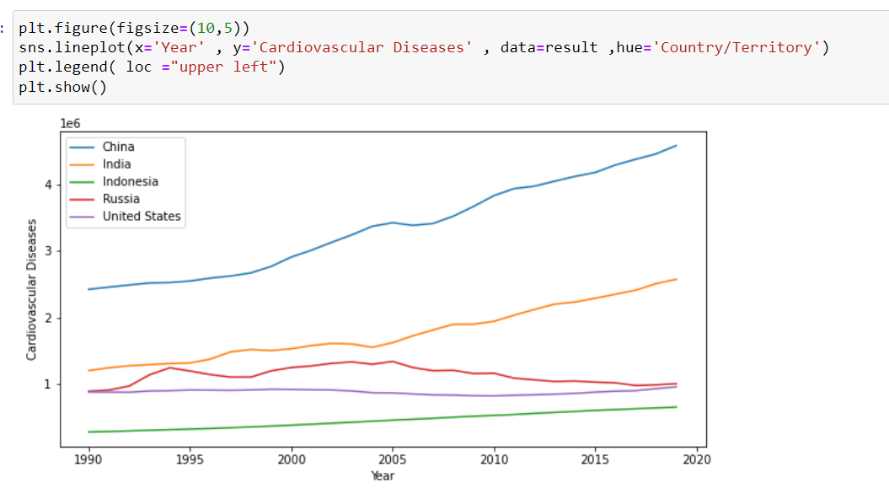
Tuberculosis VS Country
From the above Line graph, we observe people dying due to Tuberculosis is high in India there is a very slow decrease of death of people due to Tuberculosis in India, and for China and Indonesia, we observe a gradual decrease in the death ratio of people and till the year 2019 the remaining 4 countries except for India the number of death is less than 10000.
Cardiovascular Diseases VS Country
From the above Line graph, we observe people dying due to Cardiovascular Diseases are increasing in China from the Year 1990 to the year 2019, Same condition is in India but the number of people dying due to Cardiovascular Diseases is less as compared to China and for other 3 countries the count remains constant.

Slide 18
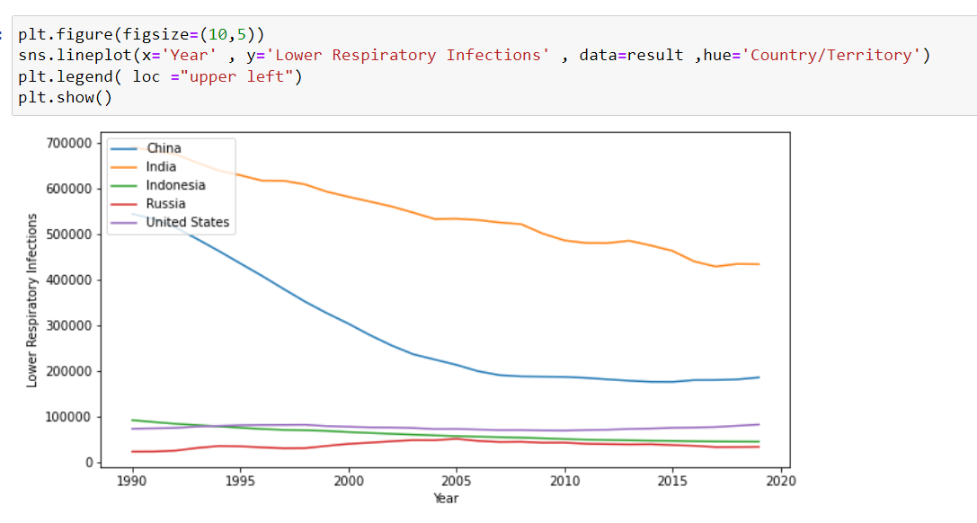
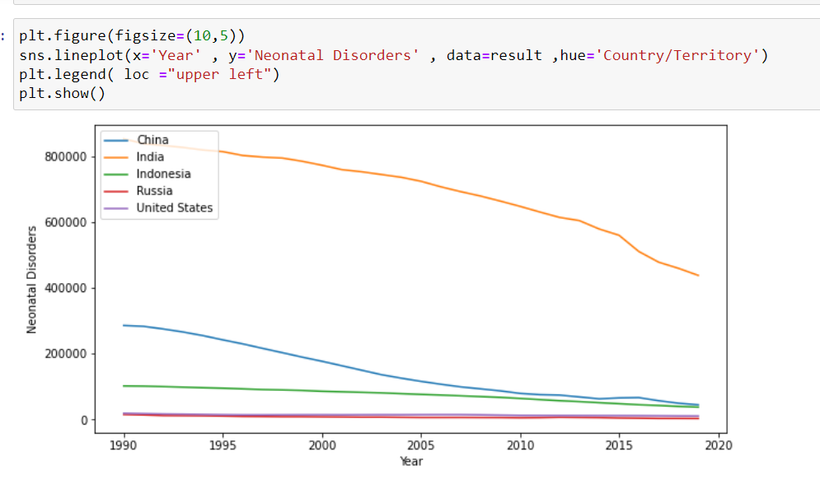
Lower Respiratory Infections VS Country
From the above Line graph, we observe people dying due to Lower Respiratory Infections was High in India and China in the year 1990 but as time passes it gradually decrease till the year 2019 for the other 3 countries the count remains constant, but for india if we observe the count for the year 2019 the people die due to Lower Respiratory Infections is very much high as compare to other 4 countries.
Neonatal Disorders VS Country
From the above Line graph, we observe people dying due to Neonatal Disorders was High in India and gradually decreasing, the count in china for starting the year 1990 was near about 300000 and the count decreased till the year 2019 which was less than 100000, and for other 3 countries the count remains constant, but for India, if we observe the count for the year 2019 the people die due to Neonatal Disorders is very much high as compare to other 4 countries.

Slide 19
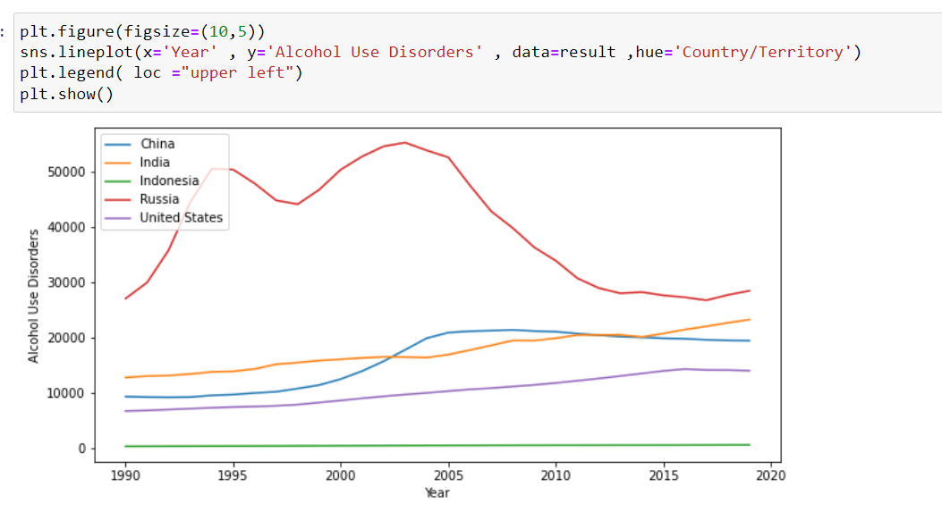
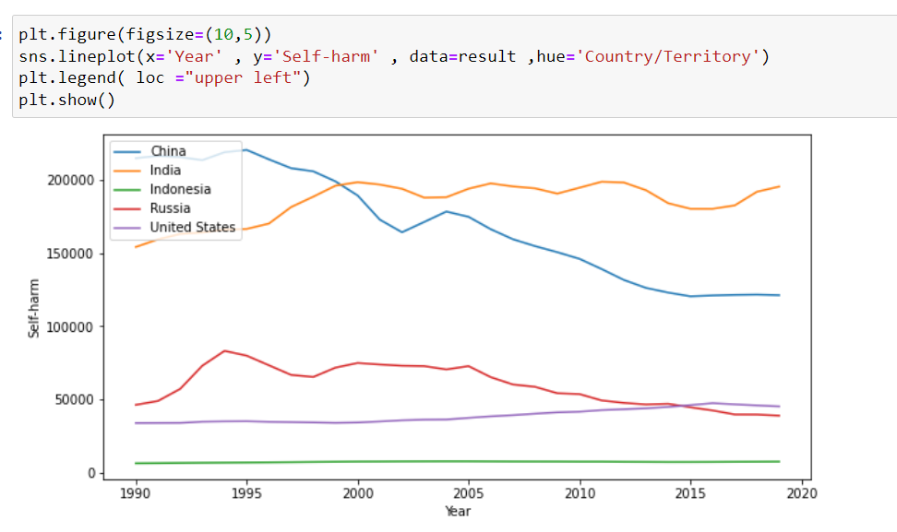
Alcohol Use Disorders VS Country
From the above Line graph, we observe people dying due to Alcohol Use Disorders was High in Russia, it remains Constant but for the other 3 countries, it gradually increased, and for Indonesia, it remains constant very less people die due to Alcohol use disorders.
Self-harm Vs Country
From the above Line graph, we observe people dying due to Self-harm is high in China and India for Russia it was increasing but later it decrease for the united states and Indonesia it remains constant.

Slide 20
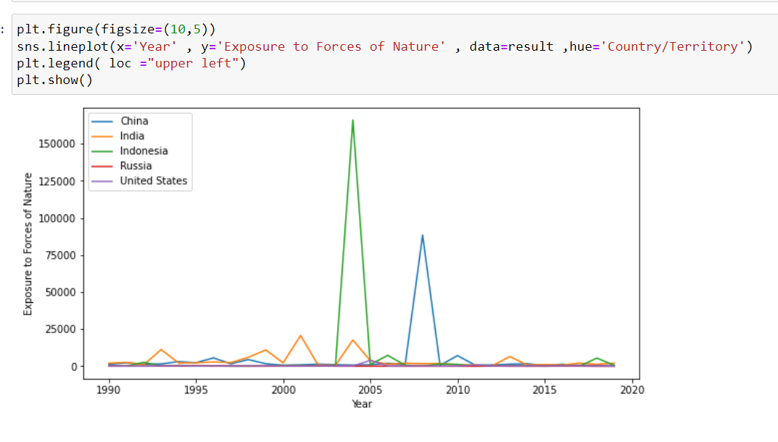
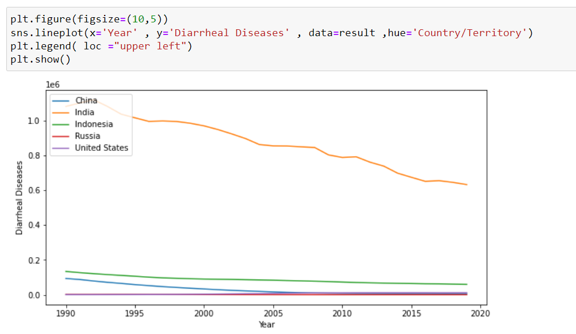
Exposure to Forces of Nature VS Country
From the above Line graph, we observe people dying due to Exposure to Forces of Nature is high in China and Indonesia for china in 2007 the people die most due to Exposure to Forces of Nature and for Indonesia in 2004 the people die most Exposure to Forces of Nature and for other 3 countries, it remains constant.
Diarrheal Diseases VS Country
From the above Line graph, we observe people dying due to Diarrheal Diseases was High in India and gradually decreasing, and for the other 4 countries the count remains constant, but for India, if we observe the count for the year 2019 the people die due to Neonatal Disorders is very much high as compare to other 4 countries.

Slide 21
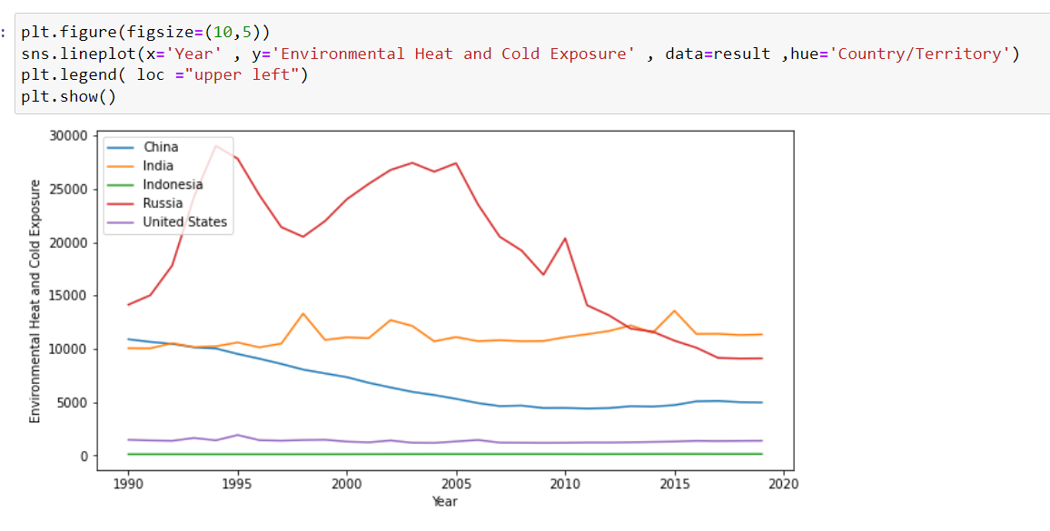
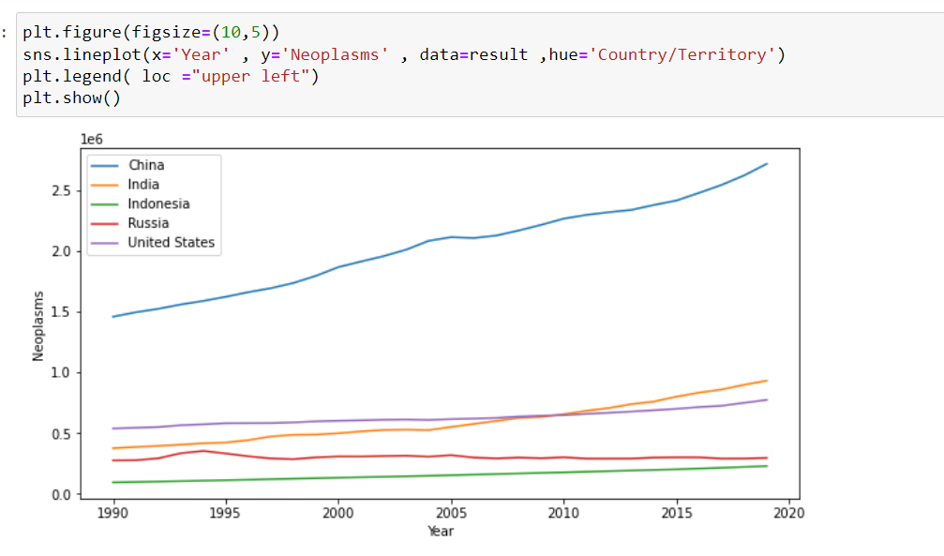
Environmental Heat and Cold Exposure VS Country
From the above Line graph, we observe people dying due to Environmental Heat and Cold Exposure was High in Russia and followed by India for china it is gradually decreasing, and for the remaining 2 countries it remains constant.
Neoplasms VS Country
From the above Line graph, we observe people dying due to Neoplasms are increasing in China from the Year 1990 to the year 2019, and for the remaining 4 countries it remains constant till the year 2010, and very little increase in death of people after the year 2010.

Slide 22
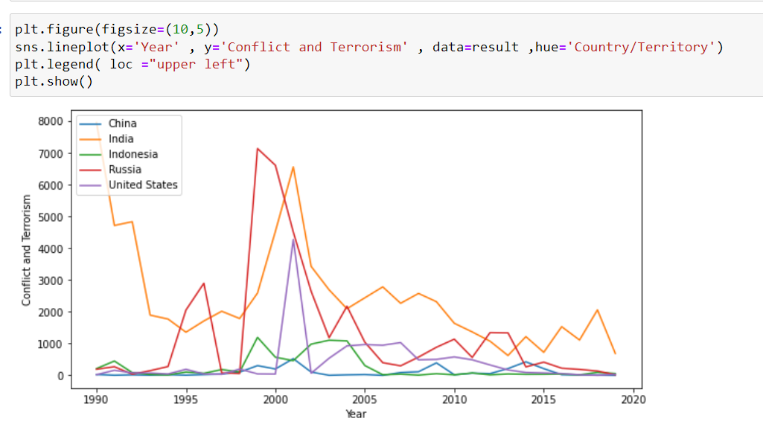
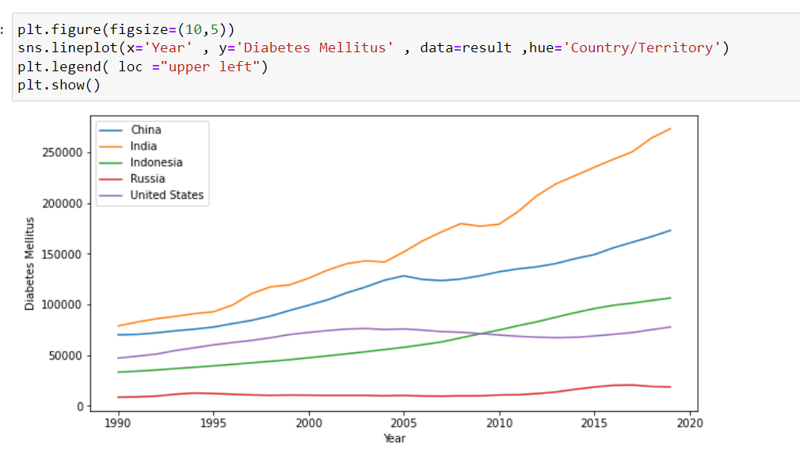
Conflict and Terrorism VS Country
From the above Line graph, we observe people dying due to Conflict and Terrorism is high in India and Russia for the united states the number of people dying due to Conflict and Terrorism was high in 2001 and after that, it decreased same for Indonesia and China.
Diabetes Mellitus VS Country
From the above Line graph, we observe people dying due to Diabetes Mellitus was less for every country starting the year 1990 but then it increase every year till 2019 except for Russia, The most people dying due to Diabetes Mellitus was high India followed by china followed by Indonesia in the year 2019.

Slide 23
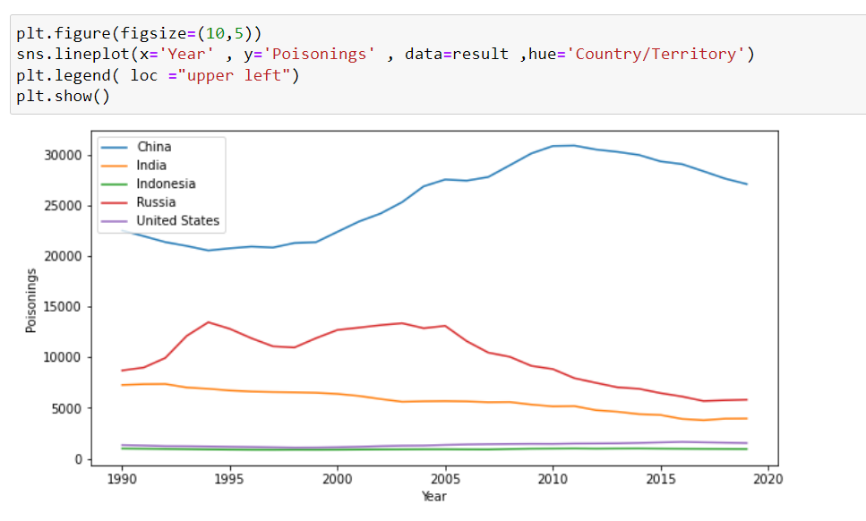
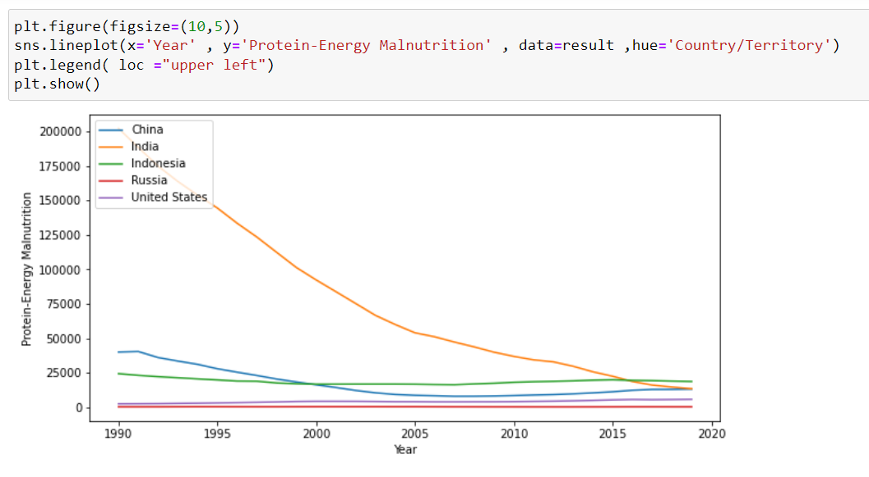
Poisoning VS Country
From the above Line graph, we observe people dying due to Poisoning was high in China and for Russia, it was high till the year 2005 after that it gradually decrease same with India for Indonesia and the united states it is very low and remains constant for all 30 years.
Protein-Energy Malnutrition VS Country
From the above Line graph, we observe people dying due to Protein-Energy Malnutrition was high in India but it rapid decrease and for all countries, the number of people dying due to Protein-Energy Malnutrition was less than 25000 in the year 2019.

Slide 24
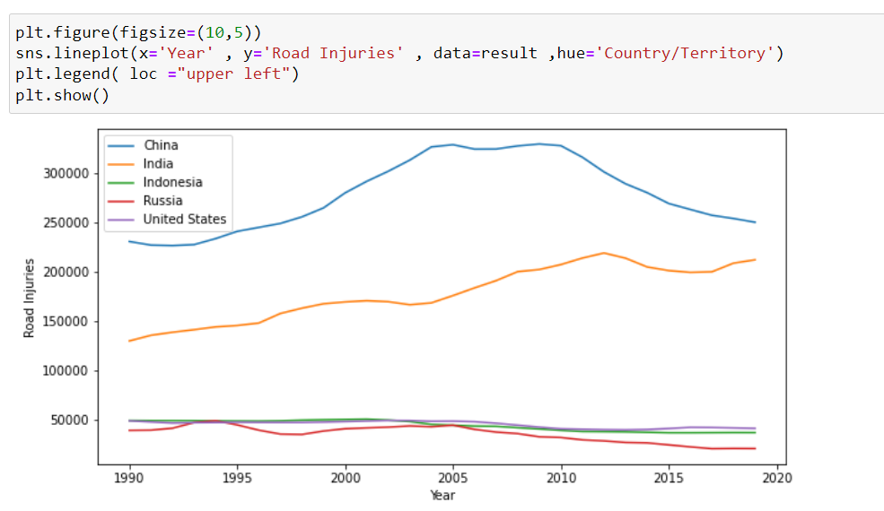
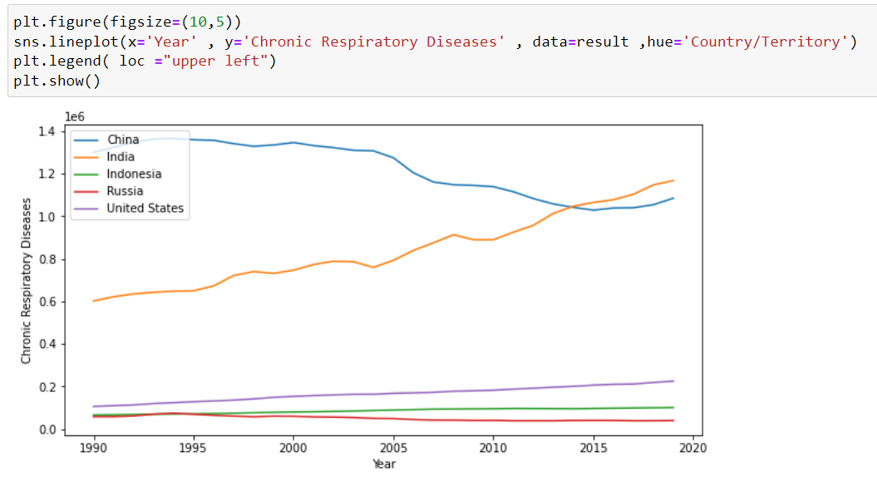
Road Injuries VS Country
From the above Line graph, we observe people dying due to Road Injuries were high in India and China and it gradually increased for the other 3 countries the number of people dying from Road Injuries was less and remains constant.
Chronic Respiratory Diseases VS Country
From the above Line graph, we observe people dying due to Chronic Respiratory Diseases were high in India and China, As for India it is gradually increasing and for china, after the year 2005 it is gradually decreasing and for the other 3 countries, it is increasing very slowly.

Slide 25
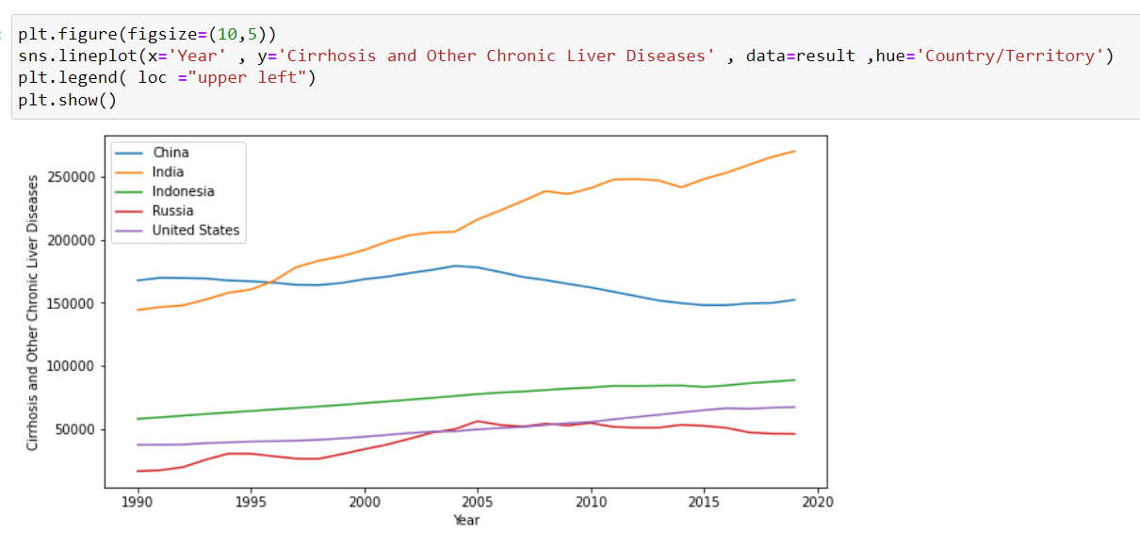
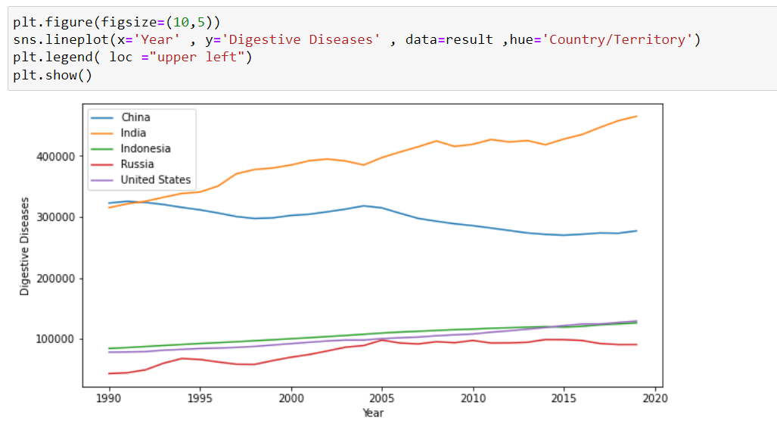
Cirrhosis and Other Chronic Liver Diseases VS Country
From the above Line graph, we observe people dying due to Cirrhosis and Other Chronic Liver Diseases were high in India and China, As for India it is gradually increasing and for china, after the year 2005 it is gradually decreasing and for the other 3 countries, it is increasing very slowly.
Digestive Diseases VS Country
From the above Line graph, we observe people dying due to Digestive Diseases were high in India and China, As for India it is gradually increasing and for China, after the year 1995 it is gradually decreasing and for the other 3 countries, it is increasing very slowly.

Slide 26
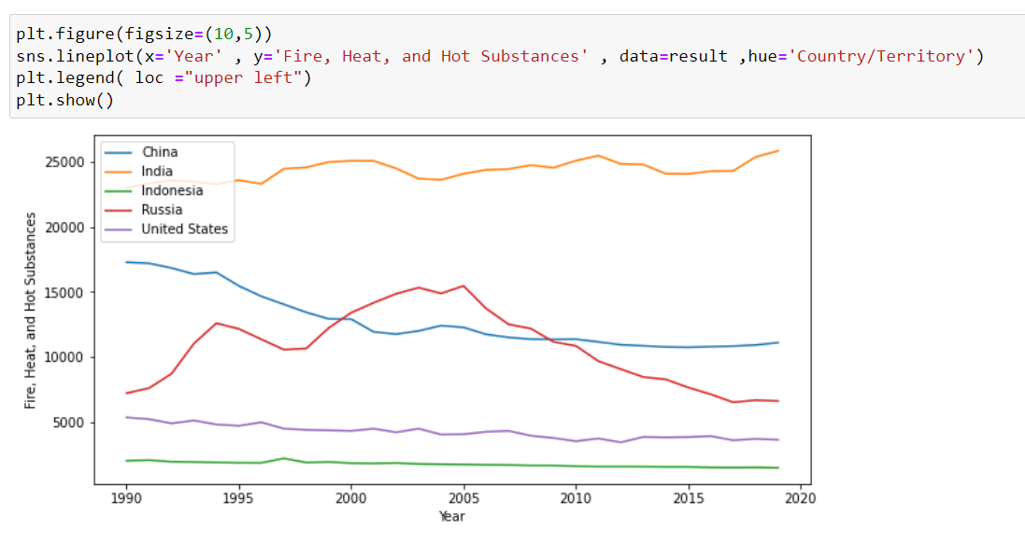
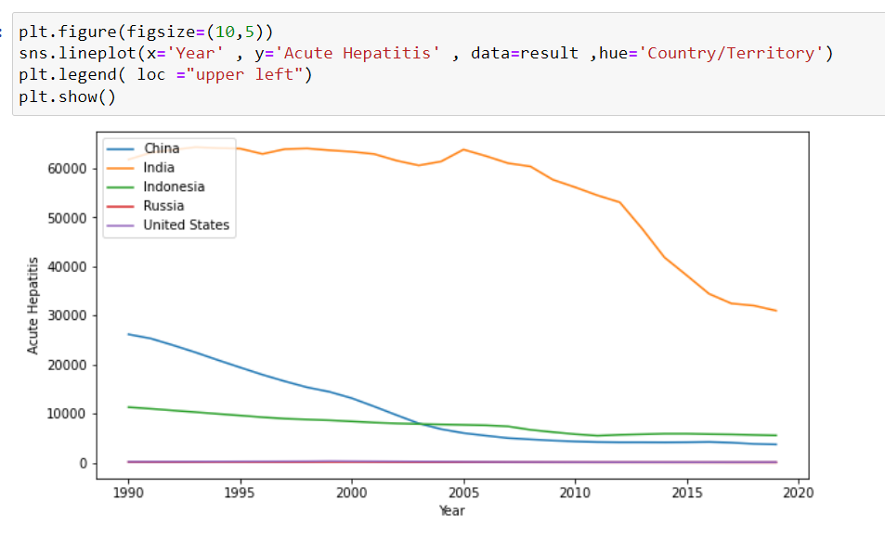
Fire, Heat, and Hot Substances VS Country
From the above Line graph, we observe people dying due to Fire, Heat, and Hot Substances were high in India and China, As for India it is gradually increasing and for china, after the year 1995 it is gradually decreasing and for Russia, it was increasing in the year 1997 but after the year 2005 it tends to decrease rapidly and for the other 2 countries, it is decreasing slowly.
Acute Hepatitis VS Country
From the above Line graph, we observe people dying due to Acute Hepatitis was High in India and gradually decreasing, the count in china for starting the year 1990 was near about 25000 and the count decreased till the year 2019 which was less than 100000, and for other 3 countries the count remains constant, but for India, if we observe the count for the year 2019 the people die due to Acute Hepatitis is very much high as compare to other 4 countries.

Slide 27
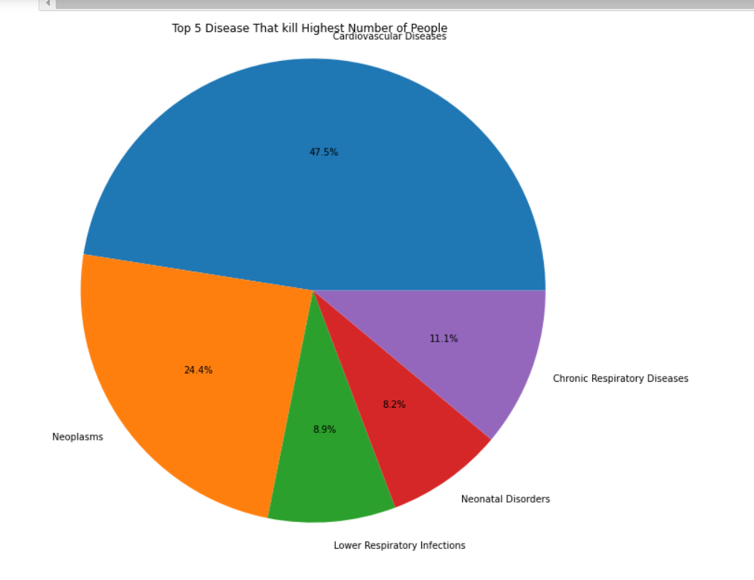
Which Top 5 Diseases Kill high number of people
The above Pie chart shows Top 5 Disease that kill high number of people
1] Cardiovascular Disease 47.5%
2] Neoplasms 24.4%
3] Chronic Respiratory Diseases 11.1%
4] Lower Respiratory Infections 8.9%
5] Neonatal Disorders 8.2%
Now we select this top 5 countries for further analysis in which Country it is most affected.

Slide 28
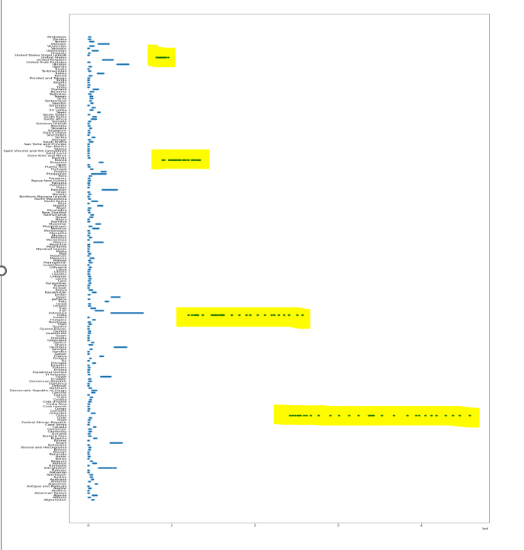
Country/Territory VS Cardiovascular Diseases
From the above Scatter plot (Country/Territory VS Cardiovascular Diseases) we observe the most number of people who died due to Cardiovascular Diseases in the countries like United States , Russia, India , China.

Slide 29
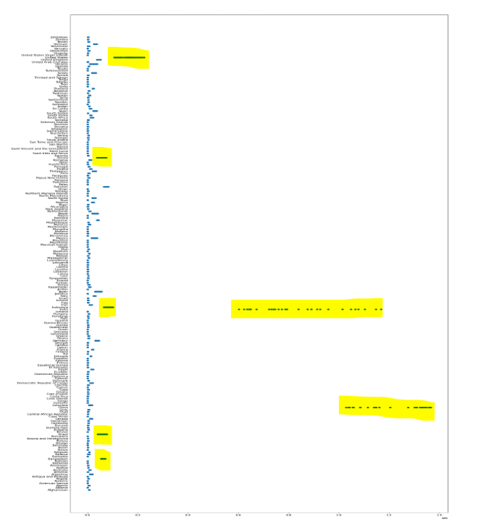
Country/Territory VS Chronic Respiratory Disease
From the above Scatter plot (Country/Territory VS Chronic Respiratory Disease) we observe the most number of people who died due to Chronic Kidney Disease in the countries like United States, Pakistan, Mexico, Indonesia, India China, Brazil, and Japan.

Slide 30
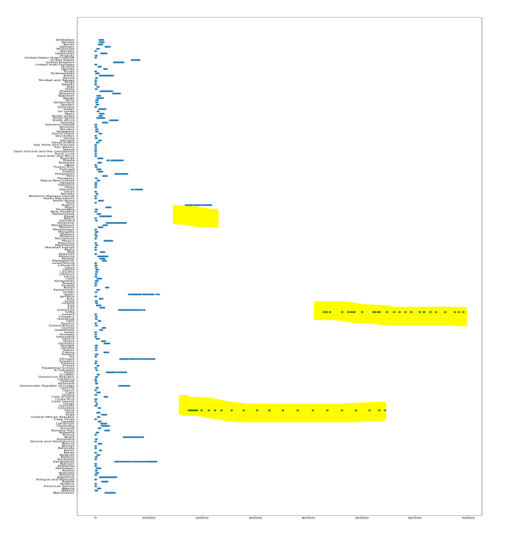
Country/Territory VS Lower Respiratory Infections
From the above Scatter plot (Country/Territory VS Lower Respiratory Infections) we observe the most number of people who died due to Lower Respiratory Infections in the countries like Nigeria, India , China.

Slide 31
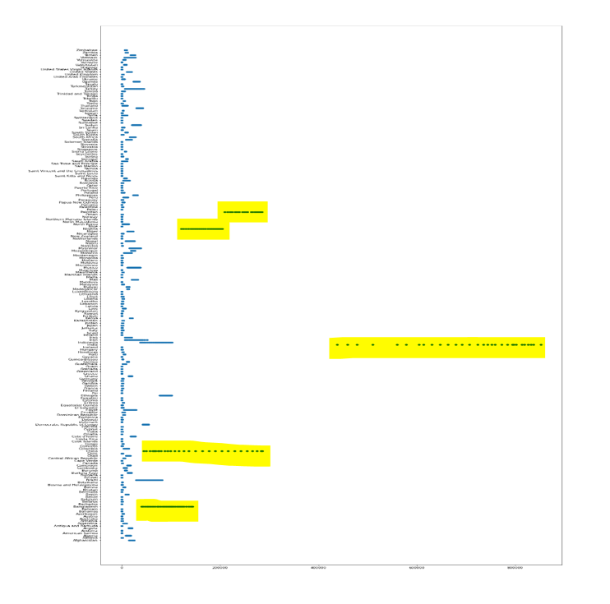
Country/Territory VS Neonatal Disorders
From the above Scatter plot (Country/Territory VS Neonatal Disorders) we observe the most number of people who died due to Neonatal Disorders in the countries like Nigeria, Pakistan, India , China , Bangladesh.

Slide 32
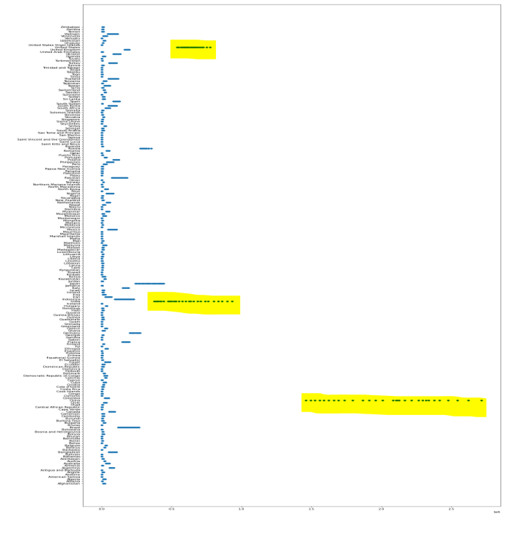
Country/Territory VS Neoplasms
From the above Scatter plot (Country/Territory VS Neoplasms) we observe the most number of people who died due to Neoplasms in the countries like United States ,India , China.

Slide 33
Conclusion
1] From further analysis, we observe the top 5 country that has high mortality and morbidity that is China, India, Russia, Unites States, and Indonesia.
2] From further analysis, we observe the top 5 diseases that kill the most people in the country are Cardiovascular Diseases, Neoplasms, Chronic Respiratory Diseases, Lower Respiratory Infections, Neonatal Disorders, etc.
3] We also further analyzed the top 5 countries why the death of people is most from which disease each country.

